Slide 1


Spice Up Your Teaching – Methodology in Practice Today
Executive Training Institute, Malta
2-6 July 2018

Slide 2


Slide 3
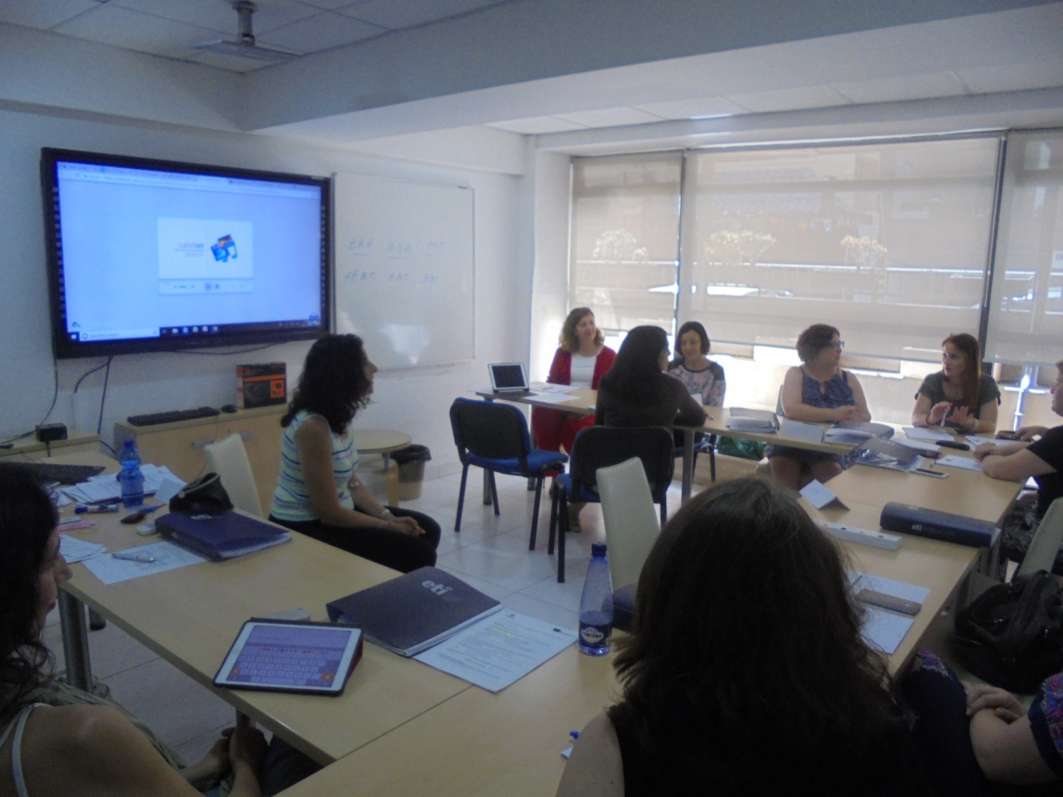

Slide 4
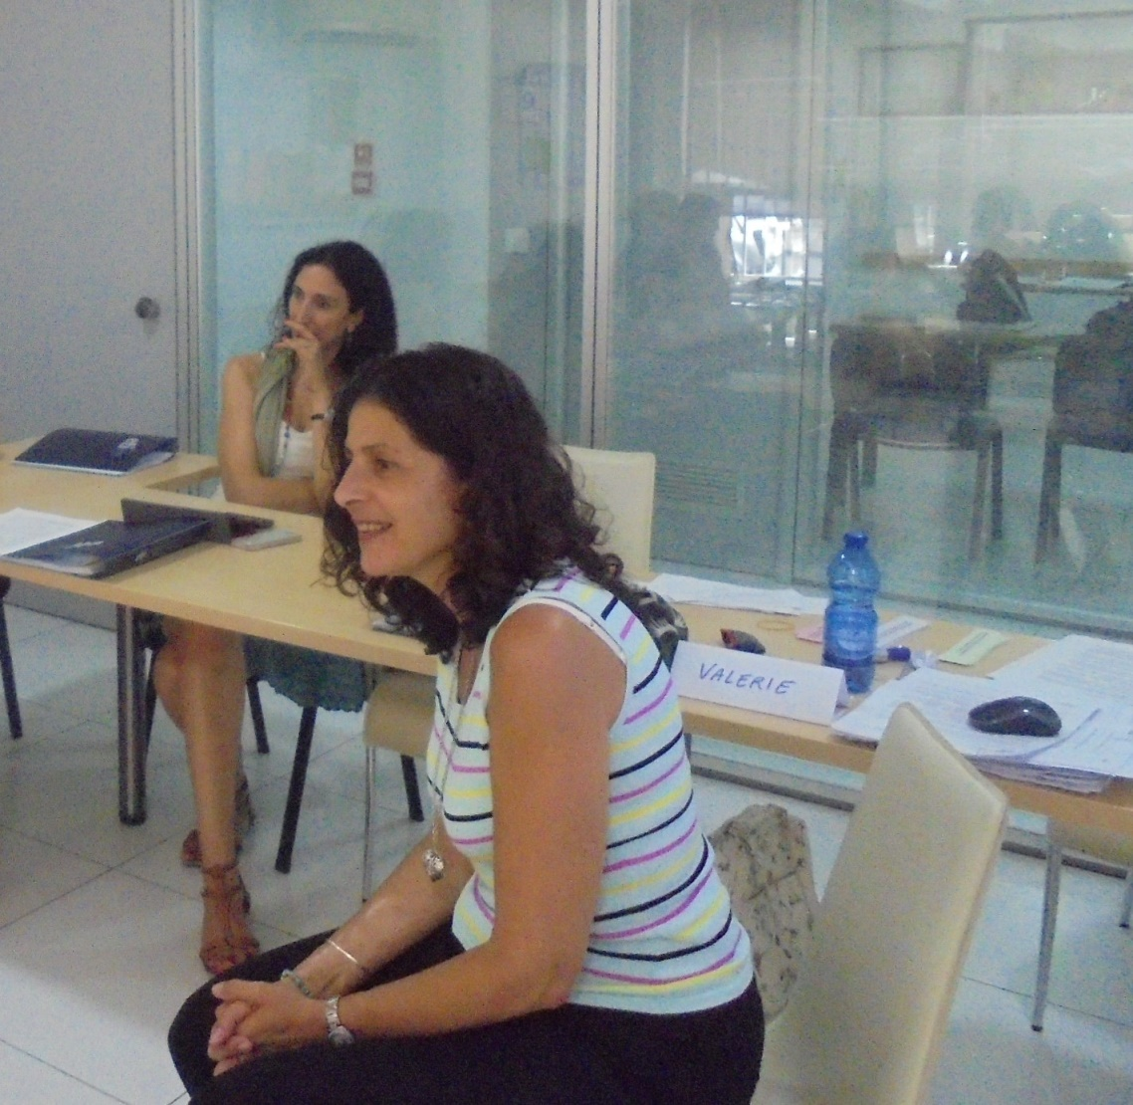
Teacher Valerie Zammit

Slide 5
Course programme
Engaging the Learner: What motivates today’s students?
Task-based learning
Learner Styles and Multiple intelligences
Collocations
Songs and Music
Tell me a story
Using computers and exploiting the Internet
Using videos and DVDs
Cuisenaire rods
Grammar practice
Co-operative learning

Slide 6
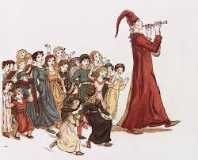
The teacher is:
A sales person
A ringmaster in a circus
A driving instructor
An encylopaedia
A social worker
An actor
A pied piper
A prison warder

Slide 7
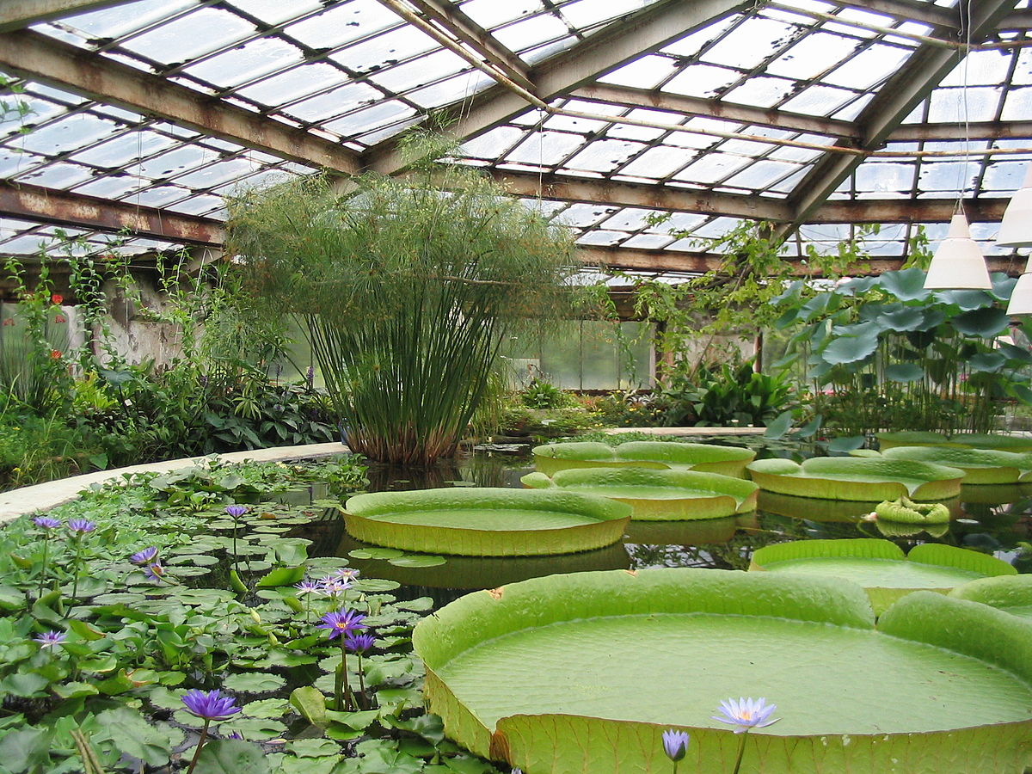
The classroom is
A greenhouse
A runway
A workshop
A prison
A courtroom
A minefield
A factory
A playground

Slide 8

Very few basic points:
The Holy Grail for every teacher is to motivate their students
Task-based learning engages students’ attention most

Slide 9
NLP (Neuro Linguistic Programming)
How we think (NEURO)
How we use language to make sense of the world to conceptualise experience (LINGUISTIC)
→ the brain can be trained (behaviour and emotion) (PROGRAMMING)
“NLPhas been around in language teaching longer than we may realise. Those teachers who incorporate elements of suggestopedia, community language learning, music, drama and body language into their lessons are already drawing on NLP as it stood twenty years ago.”
Teachers must understand that what is actually learnt by individuals is dictated by their own personal filters (beliefs', 'values', 'decisions' and 'memories‘)

Slide 10
NLP
Closely connected to Multiple Intelligences:
Visual
Auditory
Kinaesthetic
(VAK – used often, more practical, compared to the 8 intelligences)
Auditory Internal (self talk)

Slide 11
Dictation
John was driving along a quiet street at ________. The weather was _________ and he was heading to ________, because he ____________________________. He was feeling _________ because ________________. John was totally lost in thought when suddenly ____________________.
(It can be done as an opening paragraph of a story writing.
It boosts confidence of weaker ss, who don’t know how to
start).

Slide 12
Dictogloss
Example
Learners discuss pollution. Then the teacher reads a short text on the pollution to the class, who just listen. The teacher reads the text again, and the learners take notes. In groups, the learners reconstruct the text.
“The sources of pollution are numerous. The identification of these different pollutants and their effects on ecosystems is complex. They can come from natural disasters or the result of human activity, such as oil spills, chemical spills, nuclear accidents ... These can have terrible consequences on people and the planet where they live: destruction of the biodiversity, increased mortality of the human and animal species, destruction of natural habitat, damage caused to the quality of soil, water and air ...”
Dictogloss is often regarded as a multiple skills activity. Learners practise listening, writing and speaking (by working in groups) and use vocabulary, grammar and discourse systems in order to complete the task.

Slide 13
Picture Dictation
In the middle of the picture there is a big house….The house has a door and two windows….on the roof of the house there is a chimney…..In the top right hand side of the picture there is a very big sun....Beside the house and under the sun there is a little hill…. (handout)

Slide 14
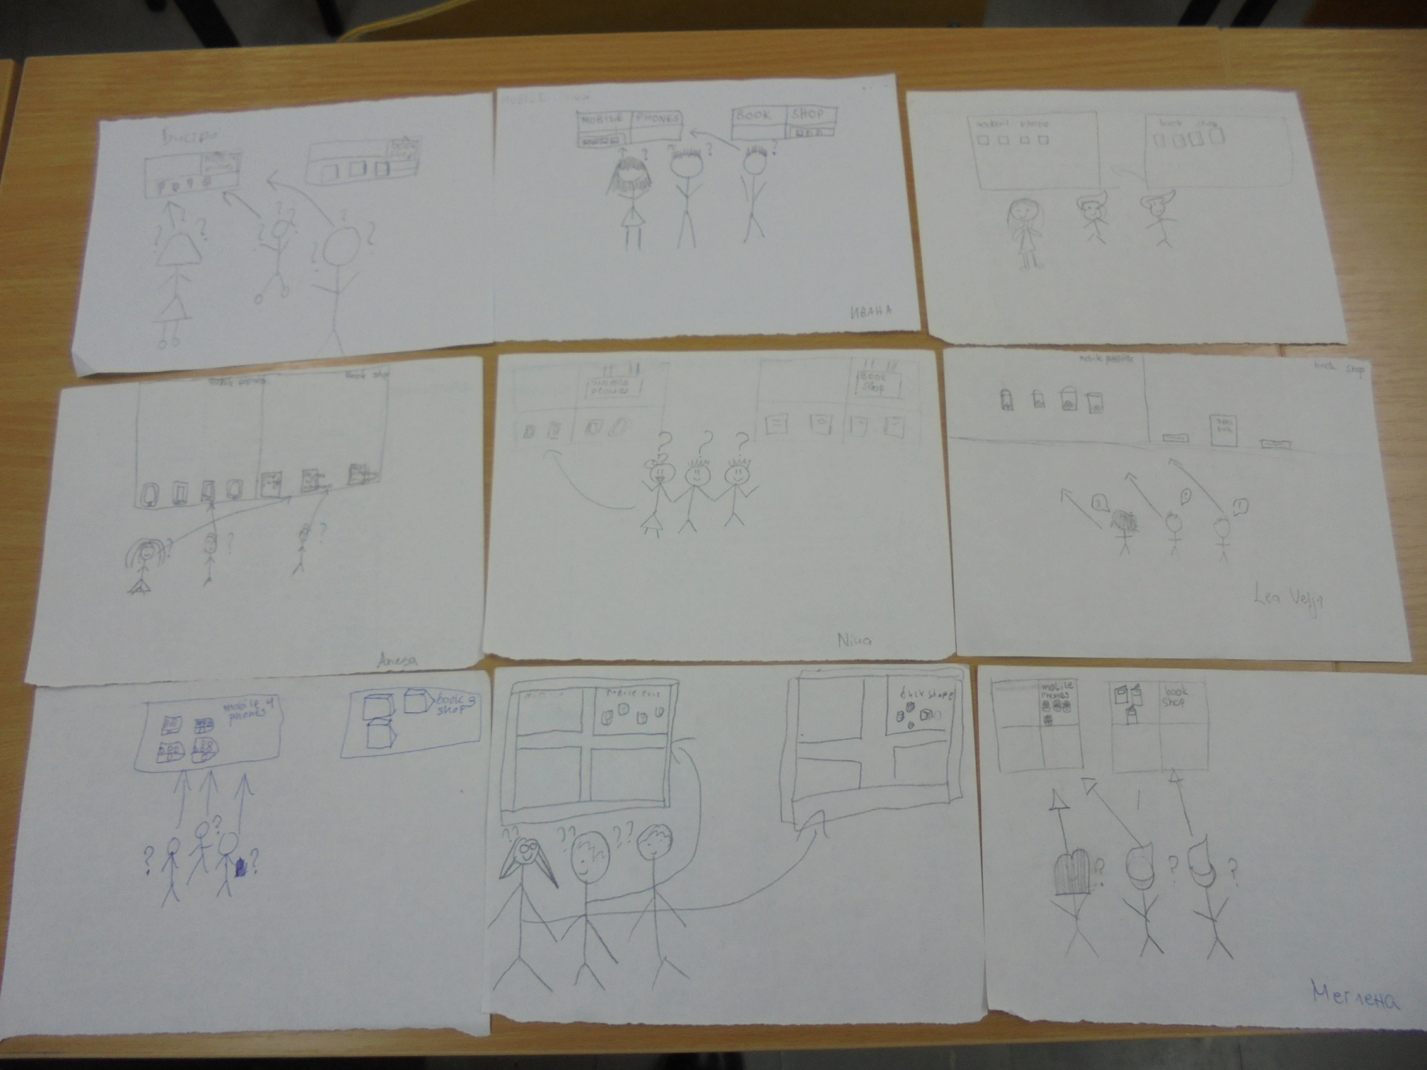

Slide 15
Cuisenaire Rods ( early1950s)
Belgian primary school teacher Georges Cuisenaire
Memorable
Appeal to VAK students
Encourage cognitive learning
Aren’t seen as ‘work’ but as fun
Increase motivation
Encourage rapport between SS and T

Slide 16
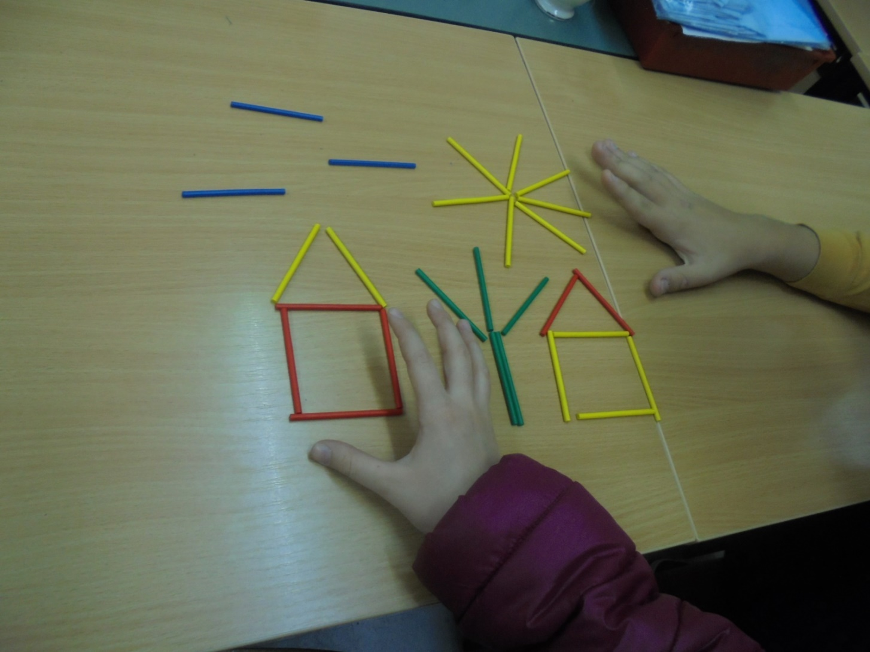
Cuisenaire Rods

Slide 17
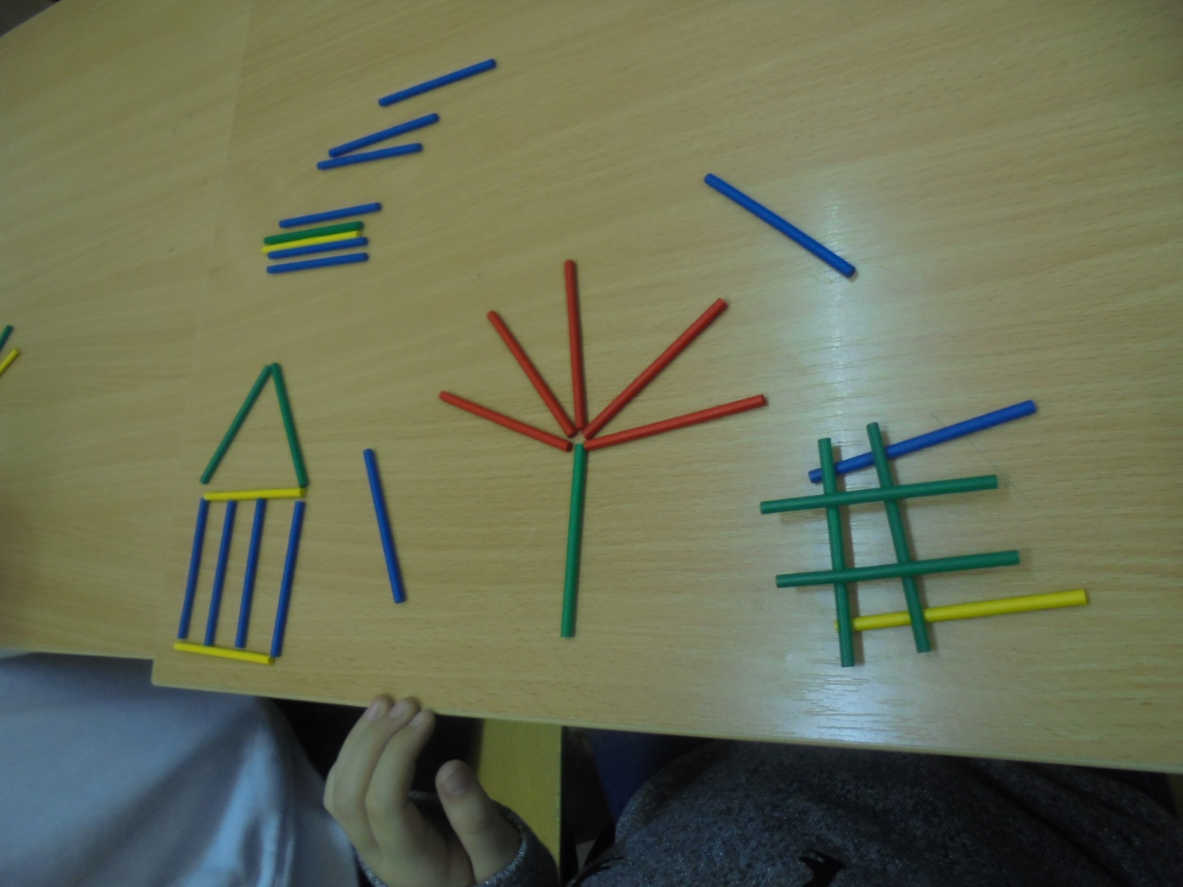

Slide 18
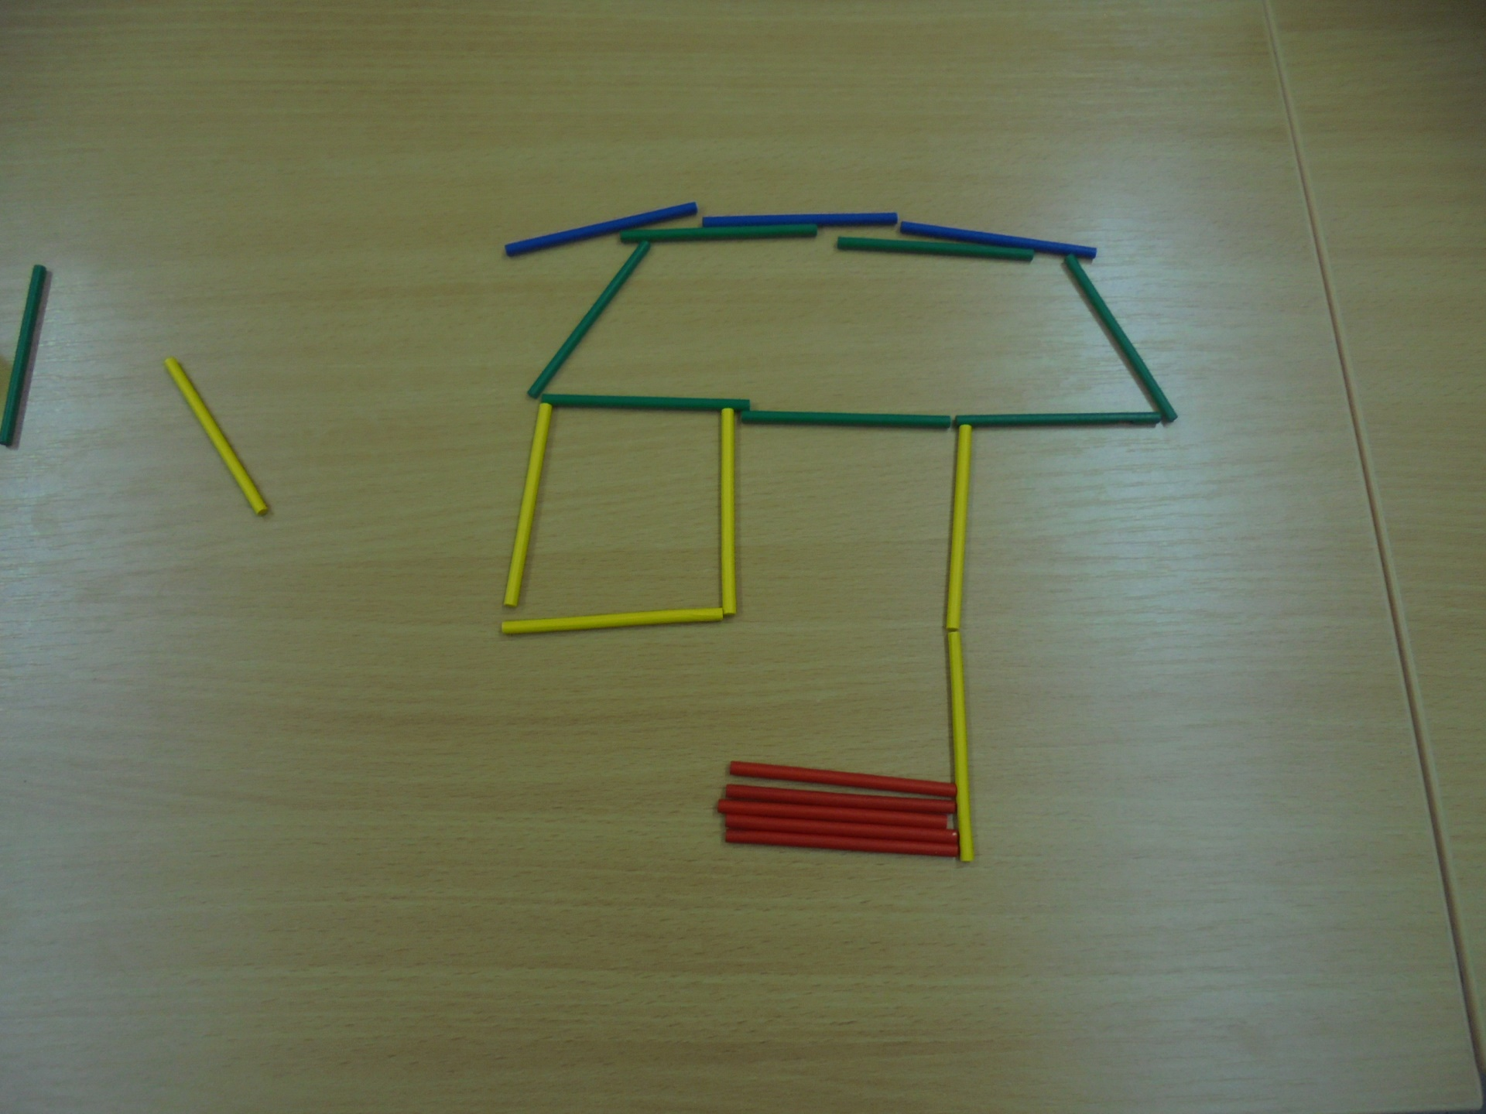

Slide 19
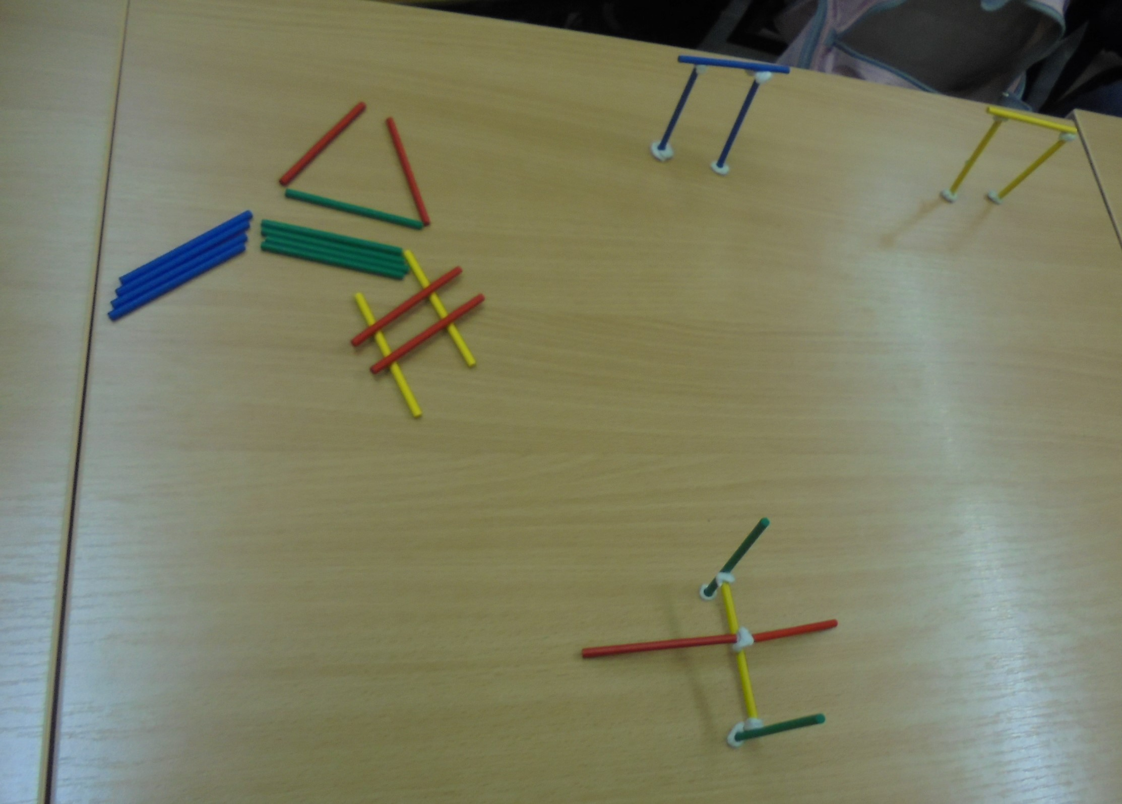

Slide 20
Cuisenaire rods
Create a scene and hide it from your partner. Describe it to them and they recreate it at the same time
Construct a typical street and ask for directions
Ss choose a colour as a representation of their current mood and talk about it
Grammar structures (e.g. colours stand for auxiliaries)

Slide 21
Cuisenaire rods
Error correction (green rods are used for correct sentences and red ones for wrong)
Colour-coding parts of speech (e.g. nouns are green, verbs red, prepositions blue, etc)
Telling the time (a clock is drawn on the board, ss stick the rods to tell the time)
Describing a room (use rods to build up pictures as you speak)

Slide 22
Vocaboxes (vocaenvelopes)
At the end of each vocabulary lesson - either you or the students should write words from the lesson on different cards. So, you may end up with ten words on ten cards and these cards are then placed in the vocabulary box.
Or simply take a photo of the board at the end of the class
If you have time, and with stronger classes, you, or the students, may write a definition of the word on the reverse of each card.
This box just becomes so flexible in how you can use it. It could be at the end of the lesson. For example 'You can't leave the classroom until you've defined two words that are in the box'. Vocabulary boxes are fantastic and they take so little time but provide so many activities.

Slide 23
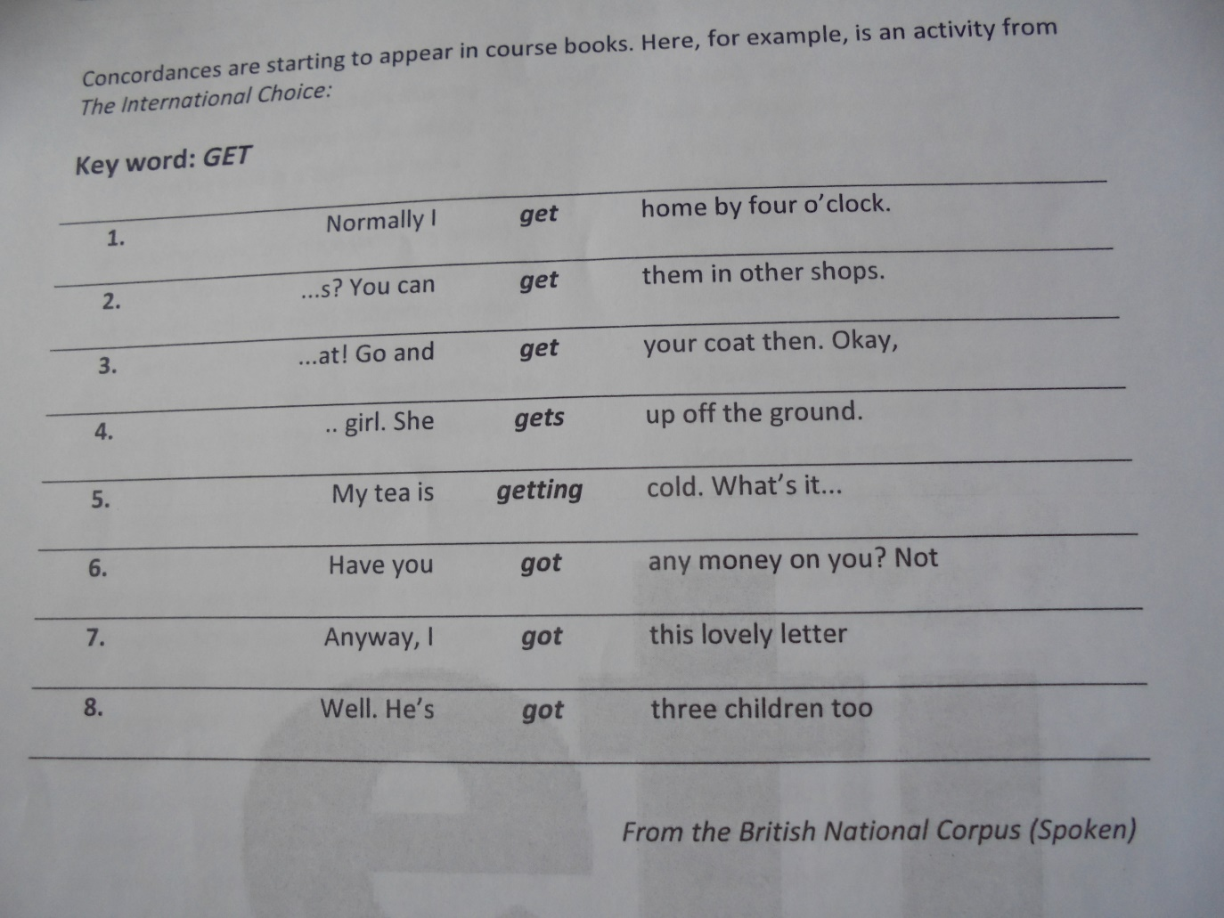
Concordances
Concordancing is a means of accessing a corpus of text to show how any given word or phrase in the text is used in the immediate contexts in which it appears (BNC - http://www.natcorp.ox.ac.uk/

Slide 24

Stories
A Fable of a Bird and her Chicks

Slide 25

Stories
The Loch Ness Monster - a guided visualisation

Slide 26
Stories
T dictates a list of 18 verbs, ss come up with a story, using only those 18 verbs in the order they were dictated:
was; went; bought; cheated; fell; hurt; shouted; ran away; thought; tried; smelled; looked for; jumped; couldn’t manage; cried out; held; felt; had

Slide 27
Exploiting the Internet
https://www.cia.gov
Suggested tasks:
1. The World Fact Book – compare and contrast 2 countries (handout)
https://www.cia.gov/library/publications/the-world-factbook/
2.The World Fact Book - Flags of the World
Pairwork: ss choose a flag and describe it to each other (handout)

Slide 28
Videos
http://lessonstream.org/
https://www.youtube.com/watch?v=nhzMhUIL0vU
https://www.youtube.com/watch?v=UtPkxzHKLpk

Slide 29
Mime
SS must mime a whole sentence (might be with a particular structure being taught). Every word is represented with a blank on the board. Every correct word is written on the board until the whole sentence is constructed or guessed

Slide 30
