Slide 1



Diversity in Education
Executive Training Institute, Malta
12 – 16 November 2018

Slide 2
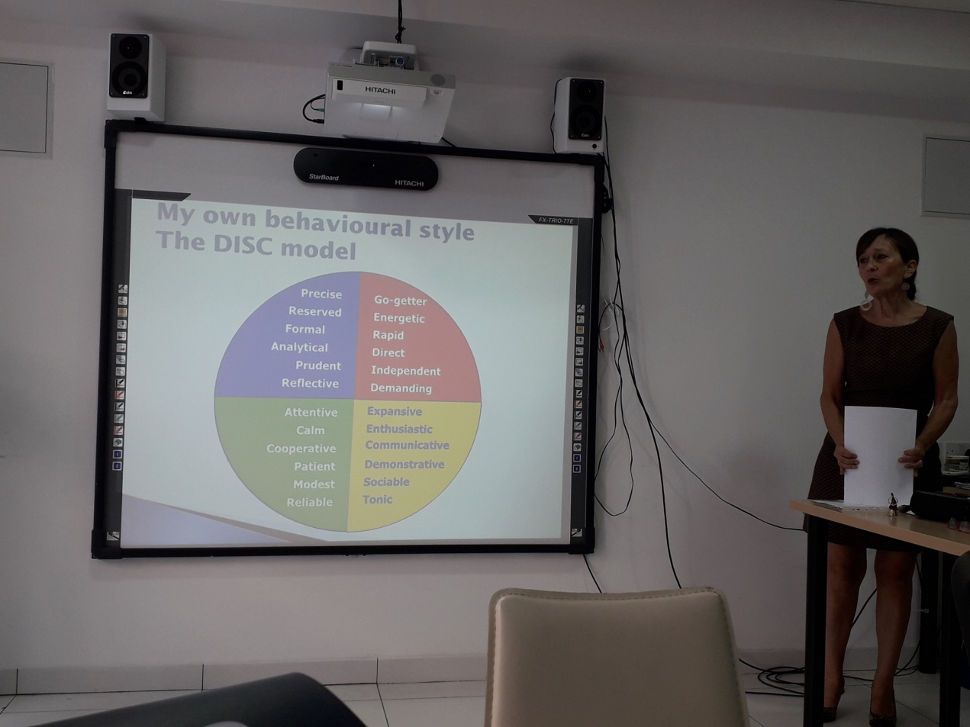
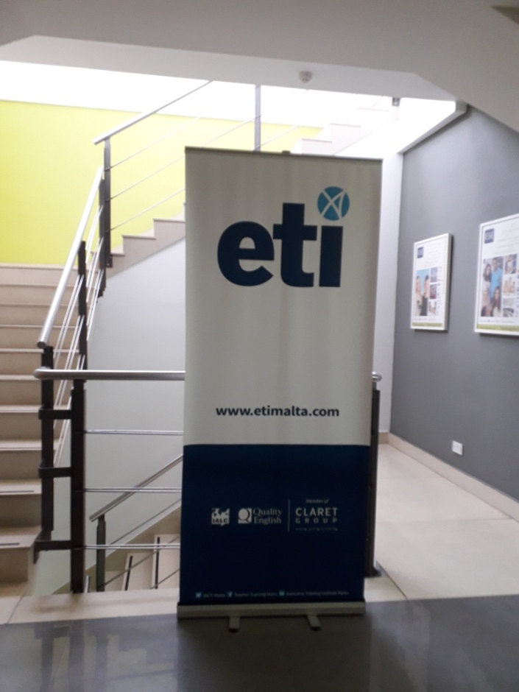
etimalta.com
Professor Judie Ibbotson
“There’s no right or wrong, only different.”

Slide 3
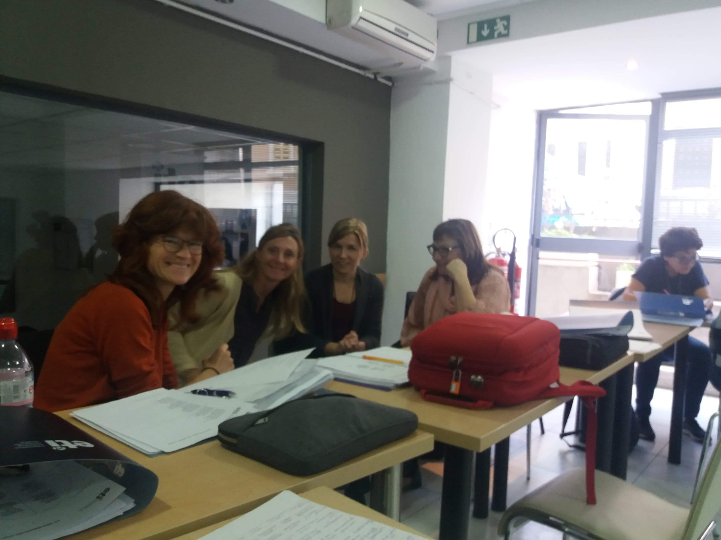
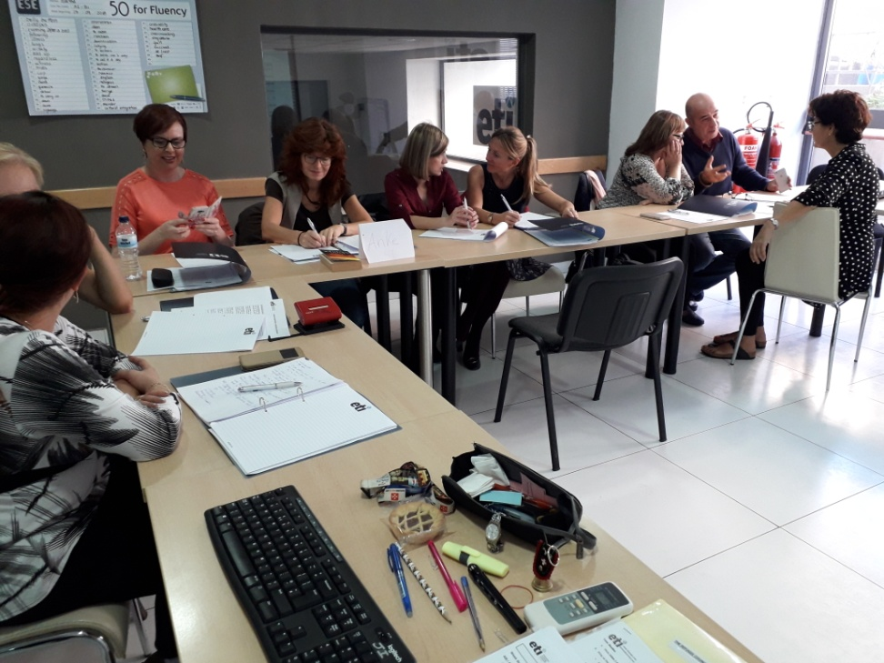
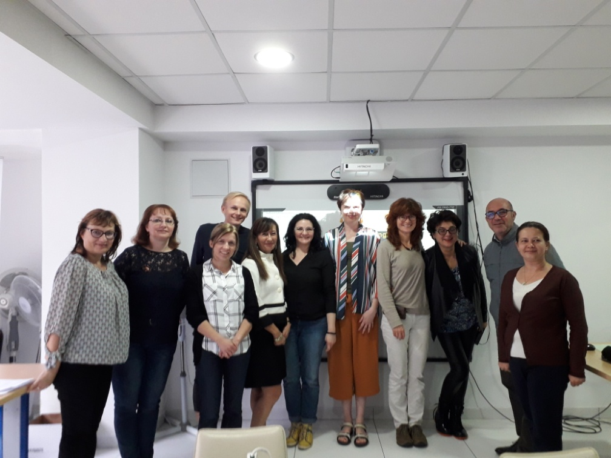

Slide 4
Course overview
Culture and intercultural competences
Refugees and migrants; case studies
Diverse abilities; integration or inclusion
Different personalities and communication skills
Training plan presentation

Slide 5
Course objectives
Gain a better understanding of the challenges of working with diversity in education
Develop an awareness of culture and its impact on behaviour, especially communication
Develop skills and competences for working with culturally diverse groups
Gain an understanding of coping with diverse abilities
Explore solutions to the challenges of working with
migrants and refugees
Gain knowledge of how to deal with different personalities
Develop a plan for integrating intercultural training into their institutions and classrooms
Develop fluency and practise expressing oneself more confidently in English

Slide 6
Getting to know each other
D&D
theatre
Skopje
Vesna
1984
2006
Nora
How many nationalities are there in this room?
How many different subjects are taught?
Has anyone got any pets?
Who speaks more than two languages?
Who loves doing sports?

Slide 7

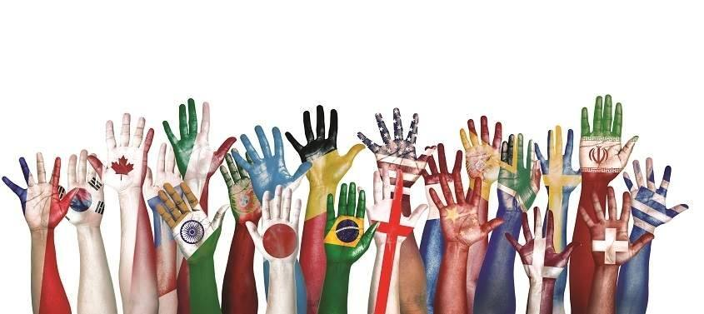
What is diversity?
Understanding that each individual is unique.
INDIVIDUAL DIFFERENCES CULTURAL DIFFERENCES
What makes individuals unique? What makes groups different?
Personality National identity
Race
Ethnicity
Gender
Age
Religion
Political beliefs
Other...
*Stereotyping is dangerous

Slide 8
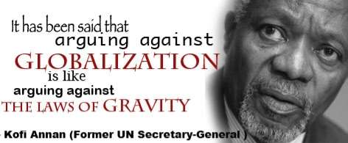
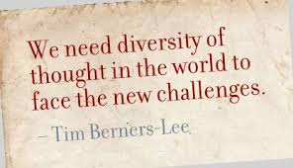
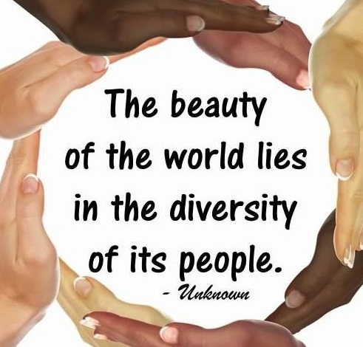
Support for Globalization and Diversity

Slide 9
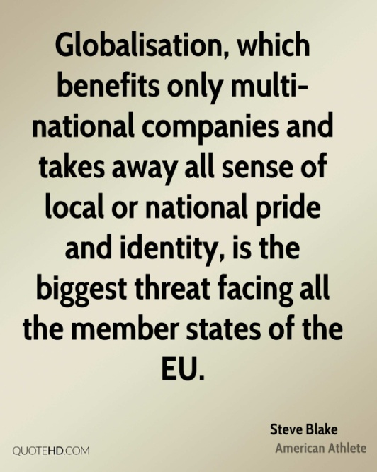


But some people see it differently...

Slide 10
Framing the Issues / The Education Picture
Cultural differences
These can cause difficulties in acceptance, and lead to prejudice and xenophobia.
Language and communication challenges
These can be a barrier to educational success, especially for migrants, refugees and their families.
Learning and teaching styles
Differences in learning and teaching styles can raise problems – both for learners and teachers.
Lack of and inaccessibility of information
Migrant / refugee parents are often unaware of their children’s right to education or are unfamiliar with the local public education system. Also, IT skills (as well as language skills) are increasingly important to access information.
5. Psychological difficulties
Trauma and other psychological difficulties are common among refugee populations, especially those forced to flee due to political, social, or religious unrest at home.
6. Residential dislocation
Many difficulties arise due to the movement of migrant / refugee students from one school to another.
7. Living conditions
Migrant and refugee children are more likely to live in substandard, crowded housing conditions than non-migrant and non-refugee children. Nick Brieger 2018

Slide 11
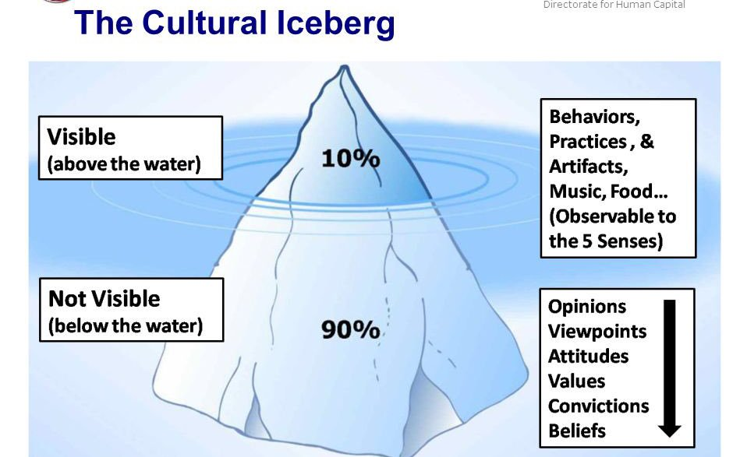

Slide 12
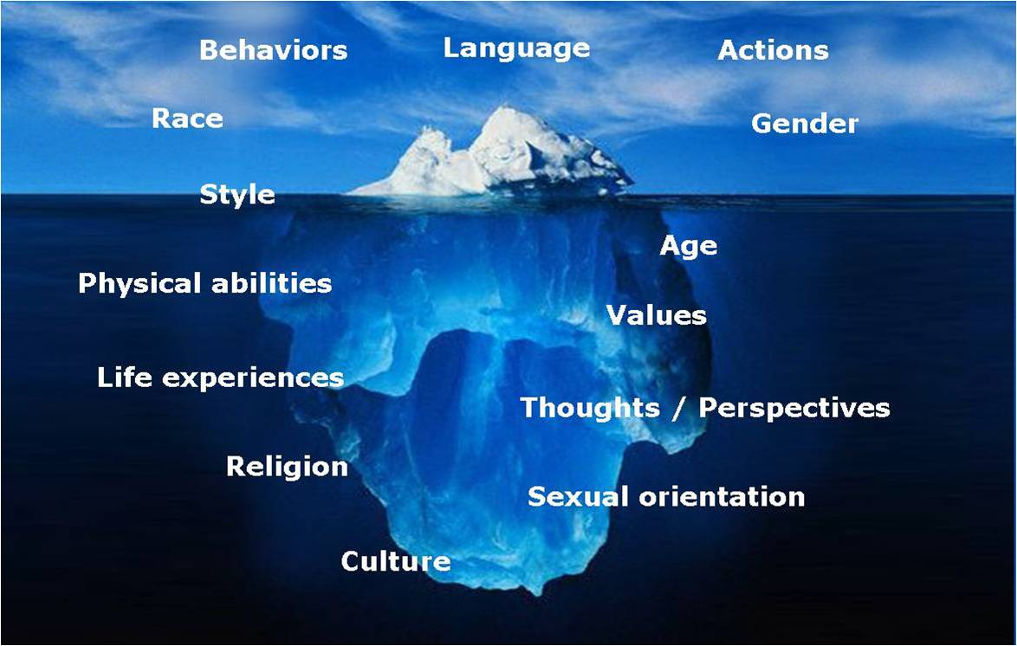
Deep Culture

Slide 13
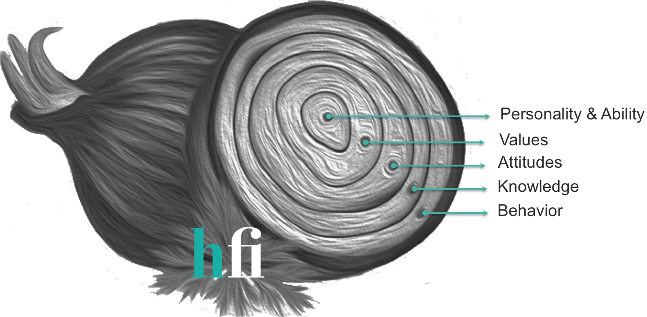
Stripping off the layers
Can you add any more layers?

Slide 14
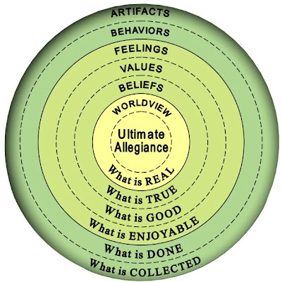
The Culture Onion
Which layers are
YOU most
influenced by?

Slide 15
Institutional Culture
Discuss the following cultural aspects in your school:
The importance of hierarchy
Respect for leadership
Planning
Cooperation vs competition
Team vs individual
Institution communication
Written/spoken formalities
Dress code
Taboos
Humour

Slide 16

A Competence model
Intercultural competence enables you to interact both effectively and appropriately when you are working in a group whose members have different cultural backgrounds.
Which of the above dimensions can be developed by training or coaching? Which one is the most difficult to develop?
Intercultural Communication Adventure with Little Pilot
https://www.youtube.com/watch?v=PSt_op3fQck
KNOWLEDGE
SKILLS
MINDSET/
ATTITUDES

Slide 17
Knowledge of Culture
  Monotask TIME Multitask
  Individualist WORKING STYLE Collectivist
  High Power Distance HIERARCHY Low Power Distance
  Risk Averse DECISION MAKING Risk Embracing
  Masculinity GENDER Femininity
  Direct COMMUNICATION Indirect

Slide 18
Intercultural Awareness
Discussion
How do these intercultural factors help you to understand diverse patterns of behaviour of your students?
To what extent do you think that your students should understand the culture of the host country?
What actions will help your students to develop intercultural awareness of the host culture?
What skills...
Do you need?
Does your class need?
Do individuals in your class need?

Slide 19
Refugees and Migrants
Refugees
Internally displaced persons
Asylum seekers
Illegal immigrants
Migrants
What does it mean to be a refugee?
https://www.youtube.com/watch?v=25bwiSikRsI
10 facts you need to know about Europe’s migrant crisis
https://www.youtube.com/watch?v=Lv8HFFByGoQ

Slide 20
Skills for Refugees / Migrants
Language: Basic speaking, listening, reading, writing
Communication: Discussion, presenting oneself, meetings, recruitment interview
Social: Small talk, communication for building social relationships, appropriate behaviour in social situations and civic society
Learning: Knowing how to learn in the classroom, eg. language learning
IT: Knowing basic IT skills for accessing information online; Knowing how to fill in online forms; basic knowledge of MS Word
Work: Skills for starting work in a range of work contexts
Dealing with officialdom: Form filling
Dealing with services: Health, housing, work, benefit, banking, etc
Other: Anything else?

Slide 21
Recognising Diverse Abilities in the Classroom
What do you understand by ‘diverse abilities’?
How do you deal with these abilities on a daily basis?
What facilities and services are available in your institution for dealing with diversity in terms of...?
Physical environment
Curriculum fit
Information
Training

Slide 22
Which Learning Style?
You have just bought a new DVD player.
What do you do to find out how to use it?
Read the manual?
Ask someone to explain to you?
Try out the different controls?
Visual Learner
Auditory Learner
Kinaesthetic Learner

Slide 23
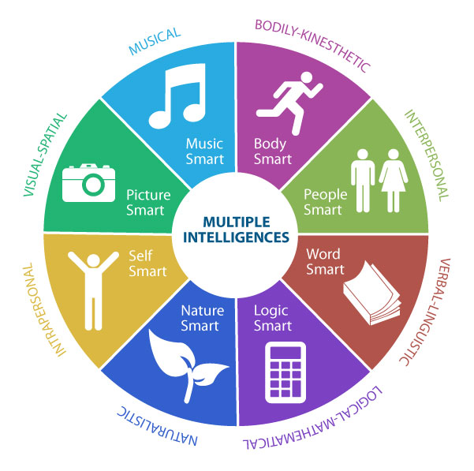
The 9 types of intelligence
https://www.youtube.com/watch?v=jVQitvk1Xtk
There is more than one type of intelligence
https://www.youtube.com/watch?v=1OINdvK6s6U

Slide 24
What is an SPLD?
By definition it is a Specific Learning Difference
It not only affects an individual’s academic achievement, but also impacts their social life.

Slide 25
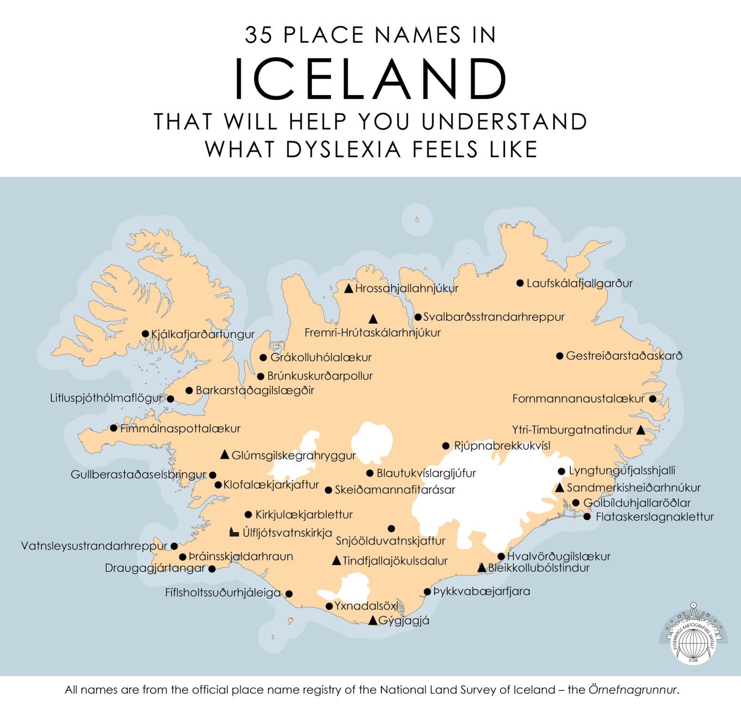

Slide 26

Long-Term Effects
Becoming demoralised
Work is disorganised and sometimes illegible/unfinished, so difficult to refer back to, resulting in SS falling behind
Could resort to misbehaving so as to conceal
their lack of achievement
Might develop low self-esteem
SS could become stressed and anxious
Will have poor reading and writing skills
Difficulty in expressing themselves
appropriately and verbally
Motivation and Determination are important
factors for someone to achieve success.

Slide 27
Personality
Task:
Write down three things about yourself that you think others will immediately see
On another paper, write down three things you think are not obvious to others (and which you would like to share)

Slide 28
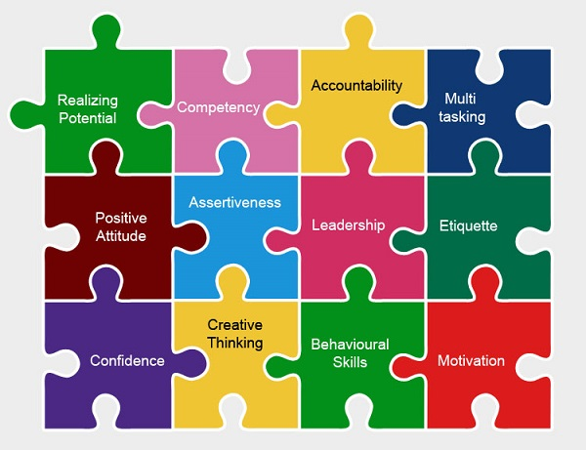
What are Soft Skills?
Soft skills are a group of personality features and interpersonal skills
that make someone compatible to work with.

Slide 29
Some Examples of Soft Skills
PRIORITISING
TIME MANAGEMENT
COOPERATION
WORKING INDEPENDENTLY
CREATIVE THINKING
POSITIVE THINKING
BUILDING CONFIDENCE
PROBLEM SOLVING
LEADERSHIP
CONFLICT MANAGEMENT
LISTENING SKILLS
NEGOTIATING
HANDLING DISAPPOINTMENT
NETWORKING
COMMUNICATION
RECOGNISING DIVERSITY

Slide 30
Communication Skills for Teachers
Teaching is generally considered to be...
...50 % knowledge
...50 % communication skills
What do these ‘communication skills’ constitute?

Slide 31
Communication Skills for Teachers
Clarity of communication – conscious of the need for a ‘low-risk’ style that minimises the potential for misunderstandings in diverse contexts.
Check for Understanding – check and clarify, rather than assume understanding of others, by paraphrasing and exploring the words you use and the meaning you attach to them.
Attuned – highly focused on picking up meaning from indirect signals such as intonation, eye contact and body language.
Reflected Awareness – conscious of how they come across to others; in diverse contexts, particularly sensitive to how their own ‘normal’ patterns of communication and behaviour are interpreted in the minds of people from other backgrounds.
Rapport – exhibit warmth and attentiveness when building relationships in a variety of contexts.
Nick Brieger 2018

Slide 32
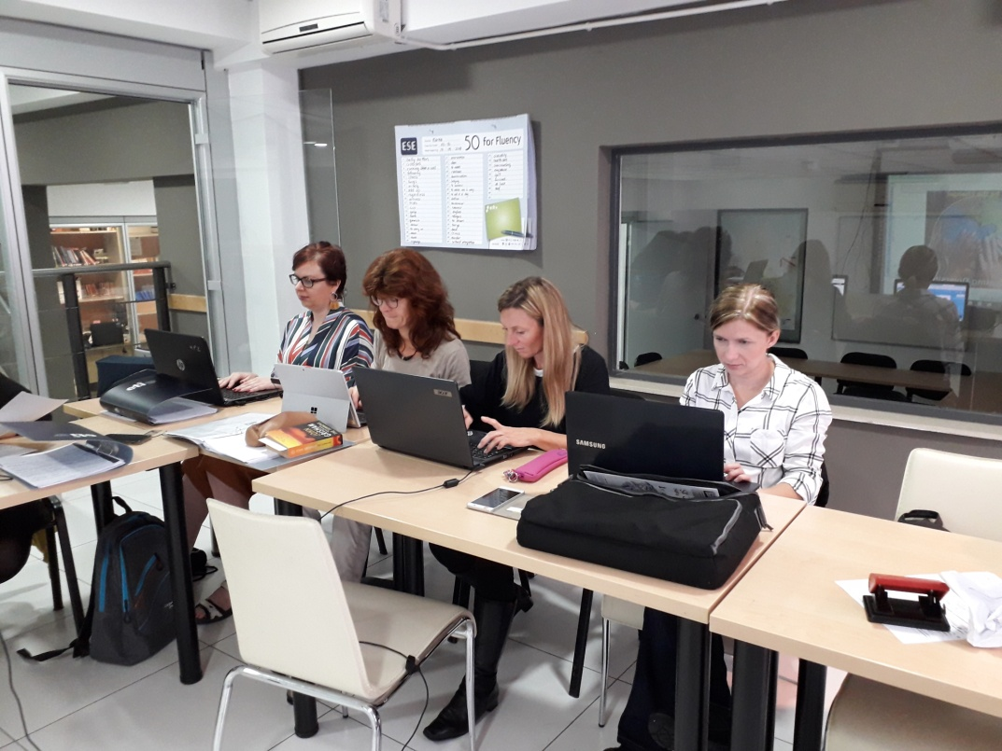
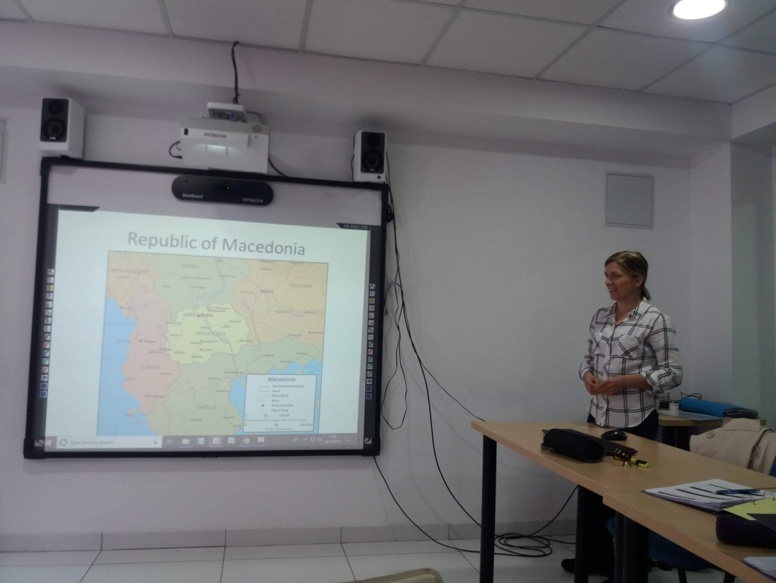
Presenting a Case Study
Feedback: buddy system

